Slide 1
Predicting Attrition using RandomForest on HR data

Slide 2
Reading the csv file
hr = fread(file = file.choose(),header=T,sep = ",")

Slide 3
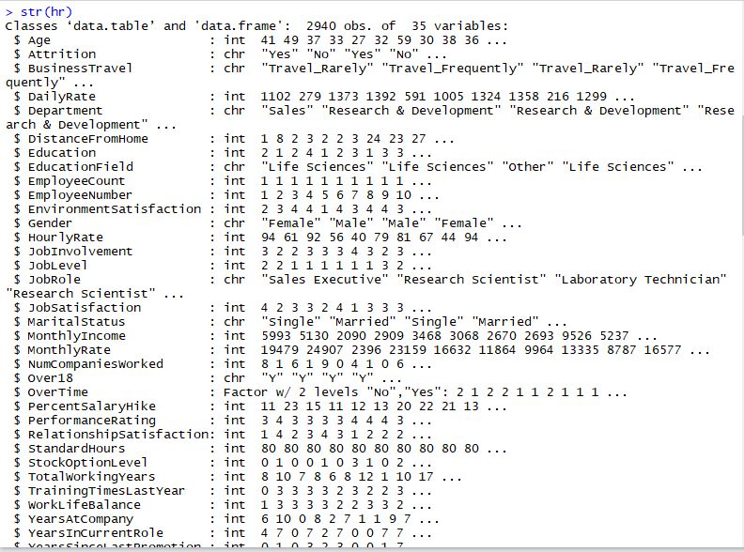
Performing exploratory data analysis
str(hr)

Slide 4
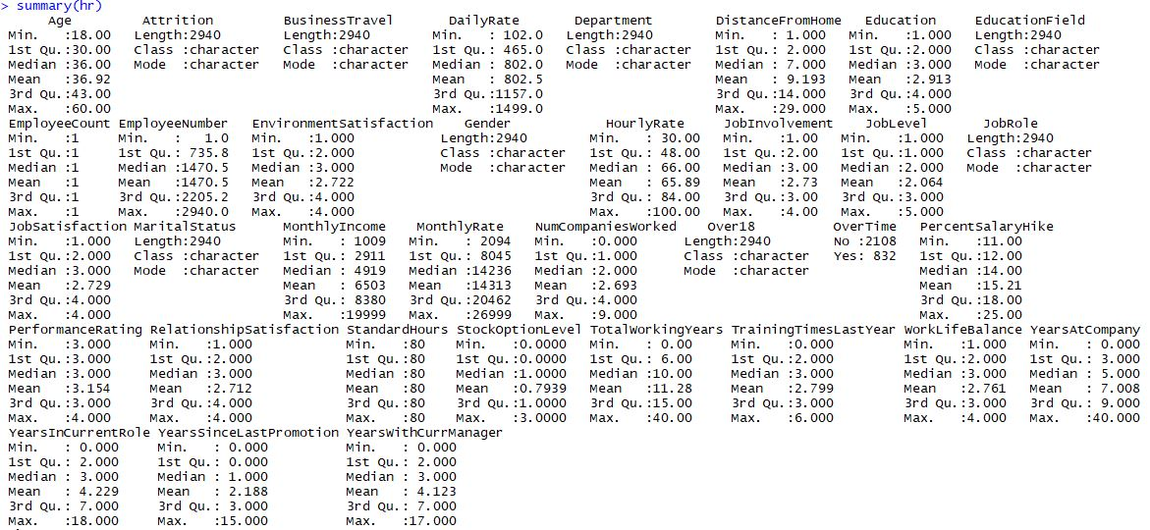
Checking summary of the data
Summary(hr)

Slide 5
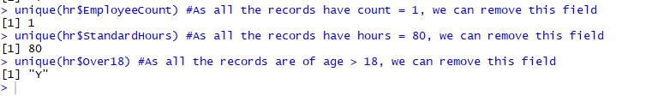
Interpreting the o/p of EDA Removing variables with same values (no variability)
hr1 = subset(hr,select = -c(Over18,EmployeeCount,StandardHours))

Slide 6
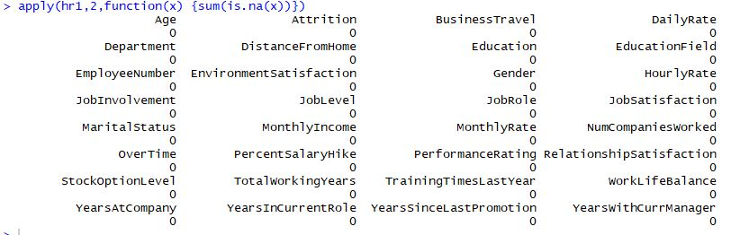
Checking missing values
No Missing values in data

Slide 7
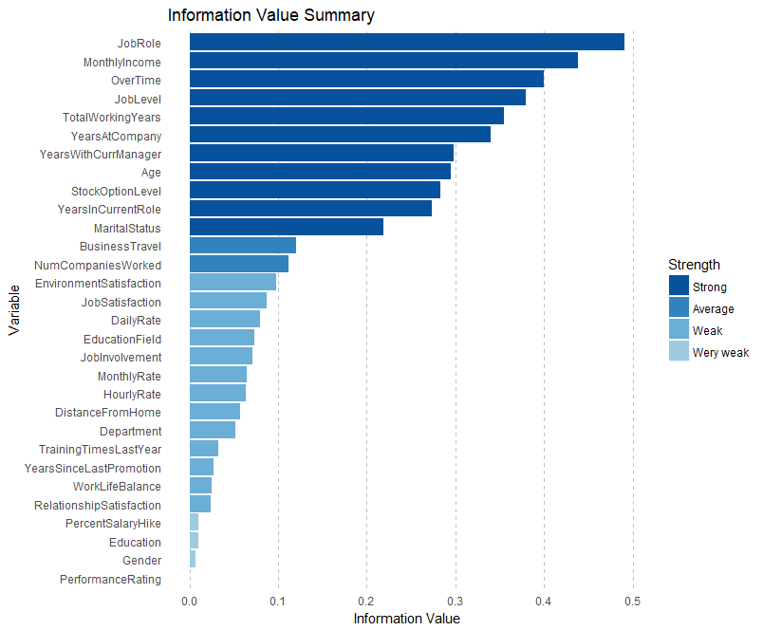
Checking Information Value for the data set
Variables –
PercentSalaryHike
PerformanceRating
Gender
Education
shows very weak strength, hence removing them from data set
hr2 = subset(hr1, select =
-c( PercentSalaryHike, PerformanceRating, Gender, Education))

Slide 8
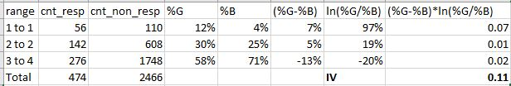
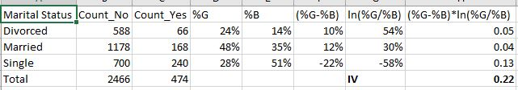
Computing IV for few variables in excel
IV for Job Involvement
IV for Marital Status

Slide 9
Visualization for each variable

Slide 12
Oversampling data set due to Class Imbalance
hr2_over = ovun.sample(Attrition~.,
data = hr2, N = 4200,seed = 1, method = 'over')$data
prop.table(table(hr2_over$Attrition))
0 1
0.5871429 0.4128571

Slide 13
Partitioning data into dev, val and test
ind = createDataPartition(hr2_over$Attrition,times = 1,p=0.7,list = F)
hr_1 = hr2_over[ind,]
hr_test = hr2_over[-ind,]
ind1 = createDataPartition(hr_1$Attrition,times = 1,p=0.6,list = F)
hr_train = hr_1[ind1,]
hr_val = hr_1[-ind1,]
table(hr_train$Attrition)
# 0 1
# 1037 729
table(hr_val$Attrition)
# 0 1
# 690 485
table(hr_test$Attrition)
# 0 1
# 739 520

Slide 14
Building RandomForest Model on Dev sample
library(randomForest)
#taking mtry as approx sqrt(no. of var) and nodesize aprrox sqrt(population)
#Employee no. not taken for model
ARF <- randomForest(Attrition ~ ., data = hr_train[,-8],
ntree=500, mtry = 5, nodesize = 100,
importance=TRUE)

Slide 15
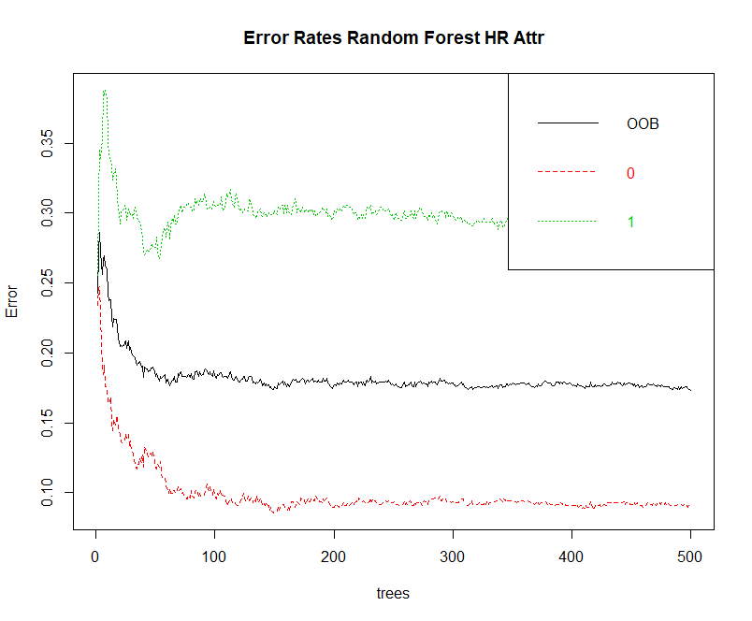
Checking optimum no. of trees
plot(ARF, main="")
legend("topright", c("OOB", "0", "1"), text.col=1:6, lty=1:3, col=1:3)
title(main="Error Rates Random Forest HR Attr")
ARF$err.rate

Slide 16
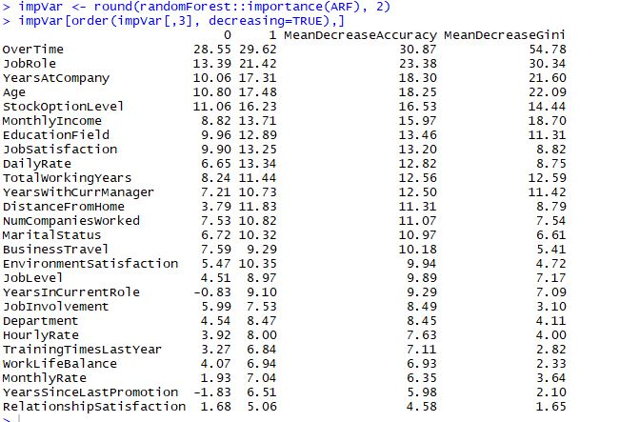
Checking Importance of Variables

Slide 17
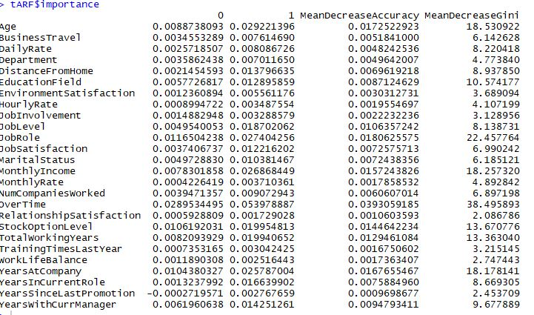
Tuning the RF with parameters
tARF <- tuneRF(x = hr_train[,-c(2,8)],
y=hr_train$Attrition,
mtryStart = 5,
ntreeTry=60,
stepFactor = 2,
improve = 0.0001,
trace=FALSE,
plot = FALSE,
doBest = TRUE,
nodesize = 100,
importance=TRUE
)
Considering nodesize = 100
and ntrees = 60 (As seen in OOB plot)
O/P
0.03107345 1e-04
-0.06997085 1e-04
-0.05830904 1e-04

Slide 18
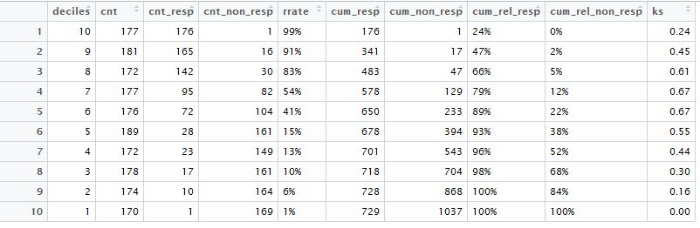
Validating Model
Scoring on dev sample
hr_train$predict.class <- predict(tARF, hr_train, type="class")
hr_train$predict.score <- predict(tARF, hr_train, type="prob")
Creating deciles based on prediction score for dev
hr_train$deciles = decile(hr_train$predict.score[,2])
Creating rank ordering and computing KS for each decile for dev

Slide 19
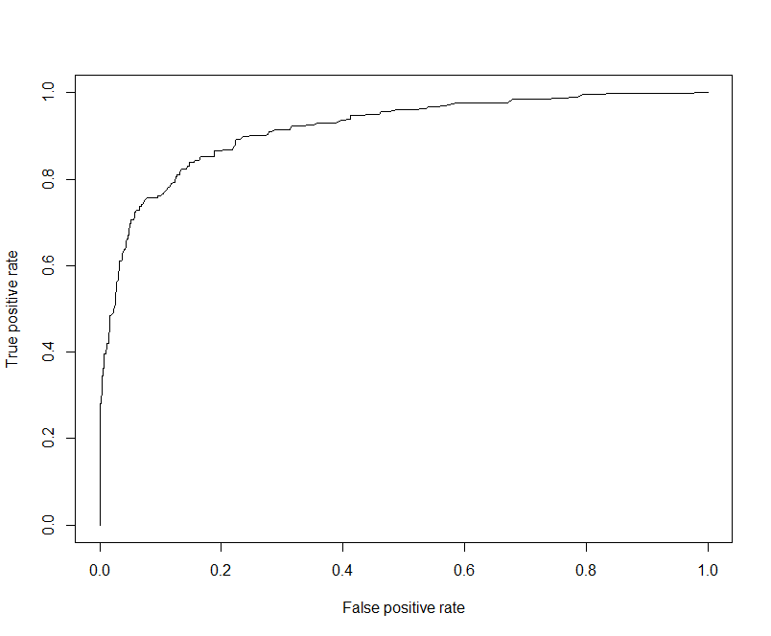
Checking Accuracy on Dev sample using ROC, AUC and KS
pred <- prediction(hr_train$predict.score[,2], hr_train$Attrition)
perf <- performance(pred, "tpr", "fpr")
plot(perf)
(KS <- max(attr(perf, 'y.values')[[1]]-attr(perf, 'x.values')[[1]]))
0.6929295
## Area Under Curve
auc <- performance(pred,"auc");
(auc <- as.numeric(auc@y.values))
0.9156174
## Gini Coefficient
(gini = ineq(hr_train$predict.score[,2], type="Gini"))
0.4243521
## Classification Error
with(hr_train, table(Attrition, predict.class))
predict.class
Attrition 0 1
0 977 60
1 201 528

Slide 20
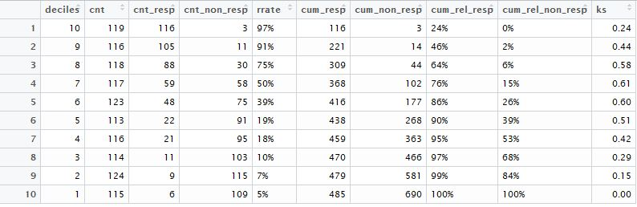
Scoring on validation sample
hr_val$predict.class <- predict(tARF, hr_val, type="class")
hr_val$predict.score <- predict(tARF, hr_val, type="prob")
#Creating deciles based on prediction score for dev
hr_val$deciles = decile(hr_val$predict.score[,2])
#Creating rank ordering and computing ks for each decile for val

Slide 21
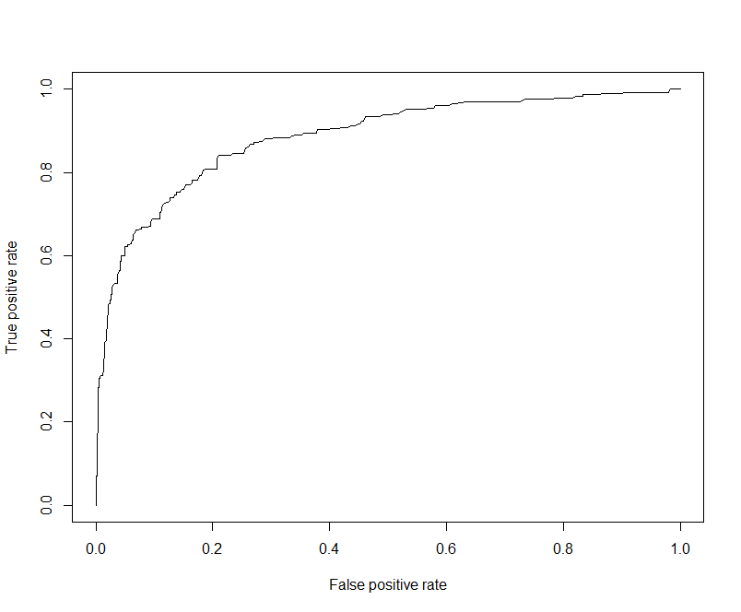
Checking Accuracy on Validation sample using ROC, AUC and KS
pred <- prediction(hr_val$predict.score[,2], hr_val$Attrition)
perf <- performance(pred, "tpr", "fpr")
plot(perf)
(KS <- max(attr(perf, 'y.values')[[1]]-attr(perf, 'x.values')[[1]]))
0.6310922
## Area Under Curve
auc <- performance(pred,"auc");
(auc <- as.numeric(auc@y.values))
0.8847363
(gini = ineq(hr_val$predict.score[,2], type="Gini"))
0.4071038
## Classification Error
with(hr_val, table(Attrition, predict.class))
predict.class
Attrition 0 1
0 646 44
1 170 315

Slide 22
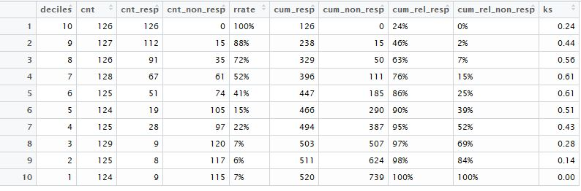
Scoring on validation sample
hr_test$predict.class <- predict(tARF, hr_test, type="class")
hr_test$predict.score <- predict(tARF, hr_test, type="prob")
#Creating deciles based on prediction score for dev
hr_test$deciles = decile(hr_test$predict.score[,2])
#Creating rank ordering and computing ks for each decile for test

Slide 23

Checking Accuracy on test sample using ROC, AUC and KS
pred <- prediction(hr_test$predict.score[,2], hr_test$Attrition)
perf <- performance(pred, "tpr", "fpr")
plot(perf)
(KS <- max(attr(perf, 'y.values')[[1]]-attr(perf, 'x.values')[[1]]))
0.6176017
## Area Under Curve
auc <- performance(pred,"auc");
(auc <- as.numeric(auc@y.values))
0.8809709
(gini = ineq(hr_test$predict.score[,2], type="Gini"))
0.4098616
## Classification Error
with(hr_test, table(Attrition, predict.class))
predict.class
Attrition 0 1
0 671 68
1 174 346

